Slide 1
Internet protocol (Part 3: Forwarding)
Rocky K. C. Chang
Chung Yuan Christian University
Dept. Information and computer engineering
March 15, 2023

Slide 2
Content
Switches vs routers
The IP forwarding problem
The IP address lookup problem
IP tunneling
Forwarding-related ICMP messages

Slide 3
Routers vs switches
Price/performance comparison
Besides packet forwarding, routers offer rich functionalities:
Support multiple network-layer protocols.
Block broadcast packets.
Provide type-of-service routing (differentiated service).
Perform admission control, per-flow queueing, resource reservation, and fair scheduling.
Assist in network congestion control.
Support tunneling
Support IP fragmentation
Perform NAT, etc

Slide 4
a router needs to worry about
Integrity of an incoming packet:
Checksum for the header
Source address spoofing (limited)
Receiving: queueing, scheduling, detunneling, etc
Dropping or forwarding
Dropping (TTL, broadcasting, congestion, and the integrity issues) and feedback
Forwarding: destination address (and perhaps source addresses and interface), and TOS.
Forwarding
Fragmentation, tunneling, source address and port translation

Slide 5
IP forwarding

Slide 6
Forwarding, routing, and switching
Routing: the process by which nodes exchange topological information to build correct forwarding tables.
Routing protocols (OSPF, BGP, IS-IS, etc)
Forwarding: the operation of deciding the next-hop address to forward to.
Forwarding table vs routing table
Switching: the operation of moving a packet from an input port to an output port.
IP router: one that forwards IP packets for others.

Slide 7
IP routing vs IP switching
IP routing protocol
IP routing protocol
Ethernet, Token ring, FDDI, etc
ATM (cell switching table)

Slide 8
The IP forwarding problem
Assume that both routers and hosts already have appropriate routing tables in place.
Routing tables for routers are constructed from routing protocols or by hand.
Routing tables for hosts are constructed from other means (to be discussed later).
Problem: Given a forwarding table and an IP packet, how do hosts and routers make forwarding decisions?

Slide 9
IP forwarding mechanisms
Routing protocol (router only)
ICMP redirect messages (host only)
Router discovery protocol (host only)
Manual configuration (router and host)
IP packets
IP forwarding table
IP Output (compute the next hop)
router only
Network interfaces

Slide 10
Exercises
Display your host’s routing table by netstat –rn.
For Unix users, you need to look up the meanings of the flags (e.g., U, G).
Locate the route for the local hosts and that for the remote hosts.
What is the IP address of the default router?

Slide 11
Types of forwarding entries
Unicast vs multicast destinations
Loopback vs actual routes
Host-specific vs network specific routes
First-hop forwarding vs last-hop forwarding vs in-between forwarding
The last two are for routers only.

Slide 12
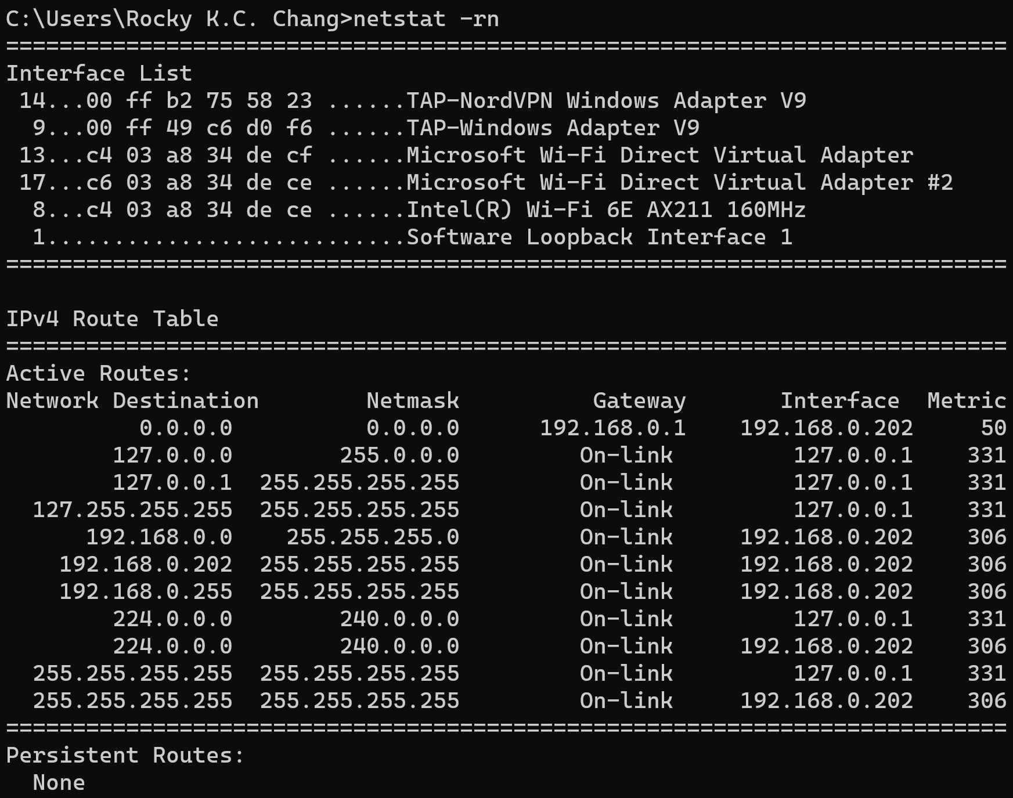
Forwarding tables in hosts

Slide 13
Forwarding tables in hosts
A host’s view about the “outside world” is binary: either local or nonlocal.
In the local case, it sends datagrams to the destination directly.
In the nonlocal case, it sends datagrams to a default router.
In both cases, the host uses ARP cache or ARP to find out the corresponding MAC addresses.

Slide 14
Exercises
Go to https://lookingglass.centurylink.com/ and find the route to 158.132.0.0 with BGP mask of 16.
How many routes to 158.132.0.0/16 do you find?

Slide 15
A subnet example
Subnet mask: 255.255.255.128
Subnet number: 128.96.34.0
128.96.34.15
128.96.34.1
H1
R1
128.96.34.130
Subnet mask: 255.255.255.128
Subnet number: 128.96.34.128
128.96.34.129
128.96.34.139
H2
R2
H3
128.96.33.14
128.96.33.1
Subnet mask: 255.255.255.0
Subnet number: 128.96.33.0

Slide 16
Routing tables
R1’s routing table:
Network/Subnet Subnet Mask Next Hop
128.96.34.0 255.255.255.128 upper int.
128.96.34.128 255.255.255.128 lower int.
128.96.33.0 255.255.255.0 128.96.34.129
H1’s routing table:
Network/Subnet Subnet Mask Next Hop
128.96.34.0 255.255.255.128 upper int.
0.0.0.0 0.0.0.0 128.96.34.1

Slide 17
Exercises
Write down the routing tables for other hosts and routers in the subnet example.

Slide 18
Bootstraping forwarding tables
Whenever an interface is initialized, a direct route (to a host in a point-to-point link or to a network in a LAN) is automatically created.
With IP address and subnet mask configured
For nonconnected networks,
Hosts to find default routers:
Configure manually through route command.
Use ICMP router discovery protocol
Use ICMP redirect
Use DHCP
Routers run a routing protocol (a routing daemon) to automatically discover routes.

Slide 19
Characteristics of IP forwarding
Both hosts and routers are involved in forwarding.
Compared with routers, a host makes a much simpler binary decision.
IP forwarding is done on a hop-by-hop basis.
It is assumed that the next-hop router is really closer to the destination.
IP forwarding is able to specify a route to a network, and not have to specify a route to every host.

Slide 20
A unicast IP forwarding algorithm

Slide 21
Exercises
For the subnet example, explain how a packet is delivered from H1 to H2.
For the subnet example, explain how a packet is delivered from H1 to H3.

Slide 22
IP address lookup

Slide 23
The IP address lookup problem
The problem: How can a router look up a destination address in its routing table as quickly as possible?
The address lookup operation is a major bottleneck in routers’ forwarding performance.
In the classful addressing architecture
Three separate tables are used for classes A, B, C addresses (the first three bits).
Use hashing or binary search to look up addresses.

Slide 24
Classless interdomain routing (CIDR)
CIDR is a solution to the class B address exhaustion and routing table size problems.
Allocate a contiguous block of class C addresses (2, 4, 8, etc) instead of a class B address.
To reduce the increase in routing table size, interdomain routing needs to perform “route aggregation.”
With CIDR, the service provider can aggregate the classful networks into a single classless advertisement.

Slide 25
CIDR examples
Inter-domain routing without CIDR
Inter-domain routing with CIDR
208.12.16.0
208.12.17.0
:
208.12.31.0
208.12.16.0
208.12.17.0
:
208.12.31.0
Service provider A
:
208.12.16.0
208.12.17.0
:
208.12.31.0
208.12.16.0/20
Service provider A
:

Slide 26
Prefix overlapping
In CIDR, a packet may match to multiple routing entries (prefix overlap), e.g.,
Addresses 208.12.16.0/24 to 208.12.31.0/24 are aggregated into 208.12.16.0/20.
Later on, the network with address 208.12.21.0/24 changed its ISP but does not want to renumber.
Now the previous addresses cannot be aggregated into a single route to 208.12.16.0/20.

Slide 27
Prefix overlapping
208.12.16.0
208.12.17.0
:
208.12.21.0
:
208.12.31.0
208.12.16.0/20 ?
Service provider A
:
208.12.21/24
Service provider B

Slide 28
Prefix overlapping
Solution: Retain the route 208.12.16.0/20 and add a separate route to 208.12.21.0/24.
The latter route is known as an exception to 208.12.16.0/20.
Use longest prefix match to forward packets to 208.12.21.0/24.
Longest prefix matching algorithms

Slide 29
Difficulty with the classless addressing
Reducing forwarding table size → more complex IP address lookup
The destination prefixes have arbitrary lengths (instead of 3 lengths).
The length of the prefix cannot be derived from the destination address in the IP header.
Searching in two dimensions: the prefix length and value

Slide 30
A classic solution based on binary tries
A binary trie is used to represent a set of prefixes, e.g.,
node a: “0”, node c: “011”, and node i: “1111”
The shaded nodes are the prefixes that are stored in the router’s forwarding table.
Nodes c and b represent exceptions to prefix “0” (node a).
Given a destination address,
Traverse the tree according to the bits in the address and remember the last prefix visited.
End when there are no more branches to take.

Slide 31
A binary trie
0
1
a
d
1
0
1
0
1
0
0
1
c
e
0
0
1
0
1
f
g
h
i
0
b

Slide 32
A binary trie
For example, the best matching prefix (BMP) for an address starting with 10110 is prefix d (1).
Updating a binary trie is simple:
Traverse the tree until there is no path to take; then insert the node.
Sequential prefix search by length
Effective if the prefixes are densely populated.

Slide 33
Path-compressed tries
Key observations:
A branch of one-child nodes in a binary trie does not help reducing the search space.
One-child nodes consume additional memory.
Approach:
Collapse the branches of one-child nodes.
Additional information stored in the one-child nodes need to be retained in the remaining nodes.

Slide 34
Path-compressed tries
1
0
1
3
2
a
d
0
1
0
1
3
b
c
e
0
1
4
4
0
1
0
1
f
g
h
i

Slide 35
Path-compressed tries
Node changes:
The two one-child nodes above b, and the one above e are removed.
Node a, being a one-child node, “moves down” to the place of its child.
New nodal information:
A number indicating which bit to be examined next.
The prefixes must be explicitly stored.
The search algorithm similar to before.

Slide 36
Path-compressed tries
For example, a prefix starting with 010110
Examining the first bit and take the left path
Compare the prefix value stored in a (0) with 010110, and remember the prefix value.
Examine the third bit and take the left path.
Compare the prefix value stored in b (01000) and do not match.
Therefore, the BMP = 0.
The path compression is useful if the prefixes are sparsely populated.

Slide 37
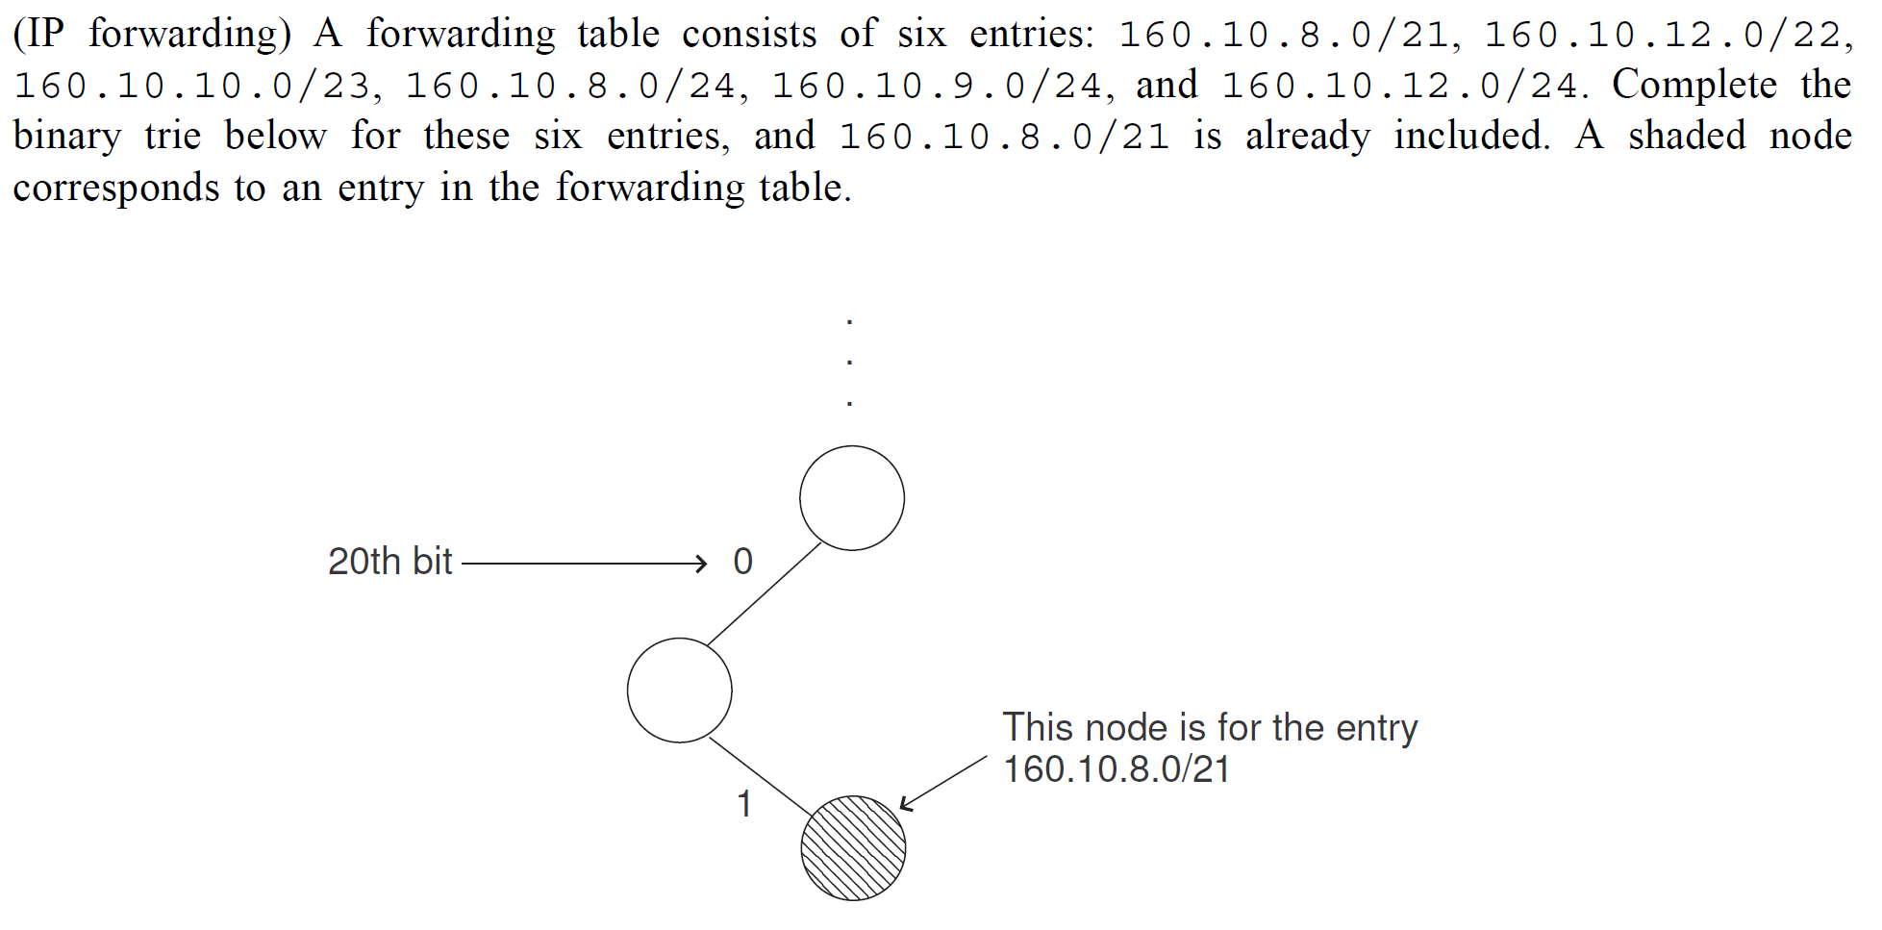
Exercise

Slide 38
Packet classification
Routers today are often required to classify individual packets into flows.
A flow is defined by a set of values in the IP header fields, such as addresses, ports, transport protocols.
For the purpose of accounting, traffic shaping, filtering policies, per-flow queueing, etc.
In general, incoming packets are subject to a classifier that consists a number of rules (with priority).

Slide 39
A packet classifier example
Rule | IP dest. addr. | IP src. addr. | Dest port | Trans-port prot | Action
R1 | 152.163.190.69/ 255.255.255.255 | 152.163.80.11/ 255.255.255.255 | * | * | Deny
R2 | 152.168.3.0/ 255.255.255.0 | 152.163.200.157/ 255.255.255.255 | Eq www | udp | Deny
R5 | 152.163.198.4/ 255.255.255.255 | 152.163.160.0/ 255.255.252.0 | gt 1023 | tcp | Permit
R6 | 0.0.0.0/0.0.0.0 | 0.0.0.0/0.0.0.0 | * | * | Permit

Slide 40
A packet classifier example
Packet header | IP dest. Addr. | IP src. Addr. | Dest port | Trans-port prot | Action
P1 | 152.163.190.69 | 152.163.80.11 | www | tcp | R1, deny
P2 | 152.168.3.21 | 152.163.200.157 | www | udp | R2, deny
P3 | 152.163.198.4 | 152.163.160.10 | 1024 | tcp | R5, permit

Slide 41
The packet classification problem
Problem: How to classify packets that can meet a number of requirements, such as the speed, storage, scalability, etc.
Longest prefix matching for IP table lookup is a special case of 1-dim. packet classification.
The length of the prefix defines the priority of the rule.

Slide 42
An example (F1 and F2 could be addresses)
42
Rule | F1 | F2
R1 | 00* | 00*
R2 | 0* | 01*
R3 | 1* | 0*
R4 | 00* | 0*
R5 | 0* | 1*
R6 | * | 1*

Slide 43
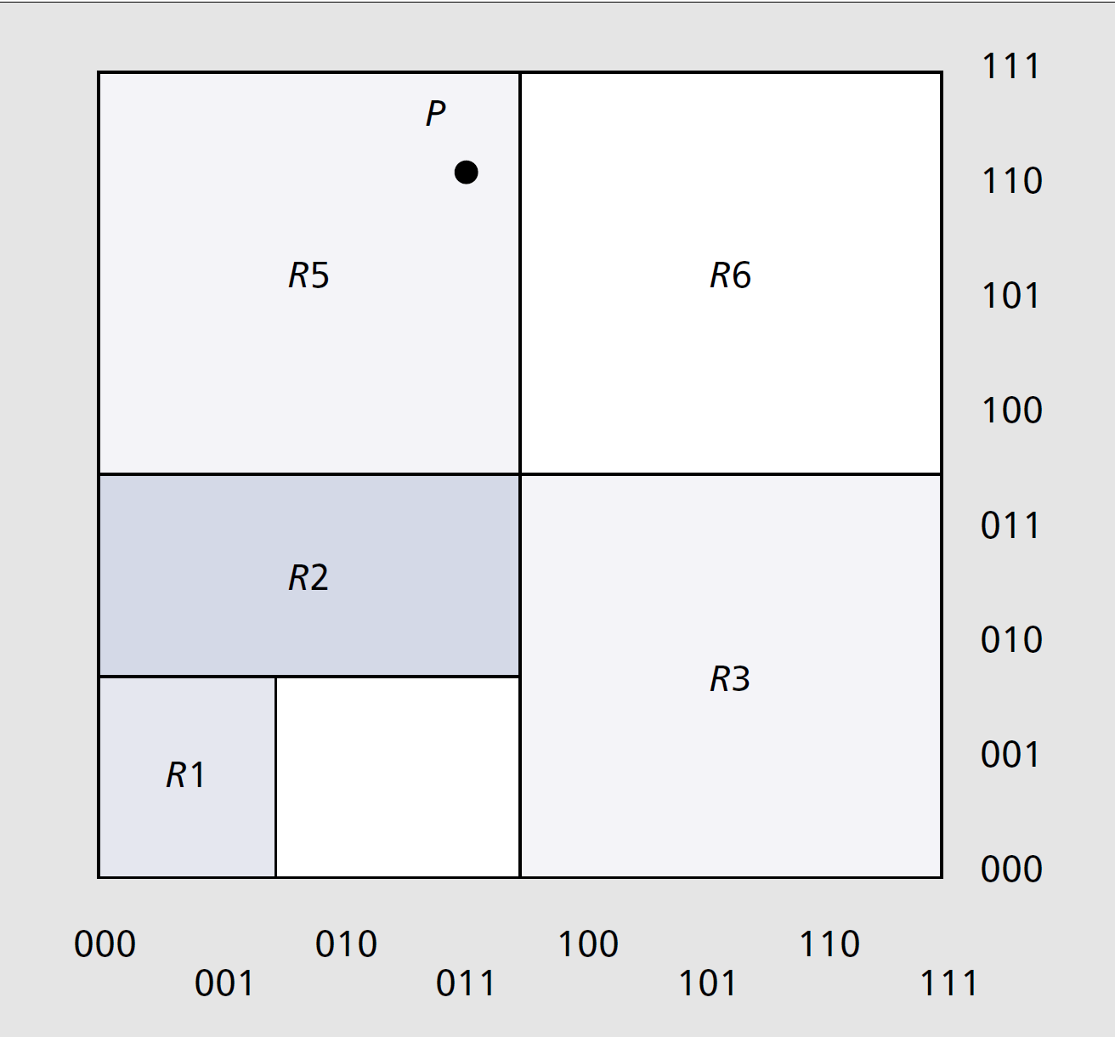
A geometric representation of the classifer

Slide 44
A d-dimensional hierarchical radix trie
0
1
F1-trie
0
0
1
1
0
0
F2-tries
0
1
R6
R3
R5
R4
R1
R2

Slide 45
A d-dimensional hierarchical radix trie
Classification algorithm:
First traverse the F1-trie based on the bits corresponding to F1.
Follow the next-trie pointers if present, and traverse the (d-1)-dim. trie.
For example, an incoming packet with (000, 010)
It matches both R2 and R4.

Slide 46
IP tunnels

Slide 47
IP tunnels
There are quite a few situations that require two network nodes (hosts or routers) to “tunnel” IP datagrams between them.
IP network
a
b
A packet destined to node d
[src = a, dest = b][original IP packet]
The original packet

Slide 48
IP tunnels
The two tunnel endpoints need to configure the tunnel states before tunneling packets.
The two endpoints treat the tunnel as another (logical) “data-link” with a new MTU value (tunnel MTU).
The sending side performs IP-in-IP encapsulation (or other encapsulation) and then the regular IP forwarding.
The receiving side performs the corresponding decapsulation and may continue forwarding the packet if it is not the final destination.
Other routers on the path forward the tunneled packets as any other packets.
Multiple tunnels may be used between a source and a destination.
Concatenation of several IP tunnels
Nesting of IP tunnels

Slide 49
For example,
49
min{MTU1, MTU4, min{MTU2, MTU3, PMTU_{2,3}−20} − 20} or
min{MTU1, MTU2−20, MTU3−20, PMTU_{2,3}−40, MTU4}.

Slide 50
Exercise
Download gre_and_4over6.cap from i-Learning.
How many headers are found in the first packet?
How many tunnels did this packet go through?
What kinds of tunnels were used?

Slide 51
IP tunnels usages
IPv4/IPv6 transitions: Two IPv6 nodes tunnels IPv6 packets through an IPv4 network.
A home agent tunnels packets destined to a mobile host to its current location.
Two IP routers tunnel packets to each other which are protected by encryption and authentication (IP Security tunnels).
Two multicast routers tunnel multicast packets through an IP network that does not support IP multicast (Mbone network).

Slide 52
ICMP messages

Slide 53
ICMP router advertisement & discovery
After bootstrapping, a host broadcasts or multicasts an ICMP router solicitation message.
One or more routers respond with ICMP router advertisement messages.
Routers periodically broadcast or multicast advertisement messages.
Multiple addresses may be advertised by a router in a single message.

Slide 54
ICMP router advertisement & discovery

Slide 55
ICMP redirect error message
This message is sent by routers (not by hosts) to a source when the datagram should have been sent to a different router.
Redirects are intended to used by hosts, not by routers.
A redirect message results in a new host-specific route in the host’s routing table.
Although redirects for network-specific route are available in ICMP, but they are not used in practice.

Slide 56
ICMP redirect error message
If the destination IP address is 140.12.1.1, a new entry for 140.12.1.1 is added to the host’s routing table after receiving the ICMP redirect message.
Host
(1) IP datagram
(2) IP datagram
R1
R2
(3) ICMP redirect
to the destination

Slide 57
ICMP redirect message

Slide 58
Exercise
Download router.pcap and find an ICMP Redirect message.
What is the new entry that will be created in the forwarding table?
Why is the Total Length in the IP header is 60 bytes, but there are 8 bytes in the TCP packet?

Slide 59
Summary
IP routers are characterized by rich functionalities that they provide
Correct IP forwarding is based on a correct routing table and a correct IP forwarding algorithm.
The address lookup performed by routers is crucial to the IP forwarding performance.
Packet classification is a generation of the longest prefix match for the IP address lookup.
IP tunnel is a very useful mechanism to solve many practical networking problems.
ICMP provides some useful queries and error reporting functions related to IP forwarding.

Slide 60
References
Chapter 1 of B. Davie and Y. Rekhter, MPLS: Technology and Applications, Morgan Kaufmann, 2000.
M. Ruiz-Sanchez, et al, “Survey and Taxonomy of IP Address Lookup Algorithms,” IEEE Network, pp. 8-23, March/April, 2001.
P. Gupta and N. McKeown, “Algorithms for Packet Classification,” IEEE Network, pp. 24-32, March/April, 2001.

